Slide 1
Blueprint for Improving Instruction, Accessibility, and Outcomes for All Students
February 17th, 2015
Sacramento Convention Center

Slide 2
The Blueprint
11:00-12:00 Building a Supportive Infrastructure
12:00-1:00 Lunch
1:00-2:15 Creating a Collaborative Educational Community
2:15-2:30 Break
2:30-4:00 Designing to Scale…Up

Slide 3
Building A Supportive Infrastructure
Access to Instruction
and Curriculum Utilizing the
Universal Design for Learning Principles
UDL Overview, “Curriculum”, and CCSS Connection
Kevin Schaefer, Assistant Director of Special Programs/WestEd

Slide 4
Common Core State Standards Implicit Considerations
Communicative Competence
Self-Advocacy
Self-Determination
Executive Functions
Social/Emotional Learning
Behavioral Expectations

Slide 5
What is Universal Design?
Ramps
Curb Cuts
Electric Doors
Captions on Television
Easy Grip Tools…

Slide 6
What is Universal
Design for Learning?
UDL provides a blueprint for creating instructional (1) goals, (2) assessments, (3) methods, (4) materials that work for everyone--not a single, one-size-fits-all solution but rather flexible approaches that can be customized and adjusted for individual needs.

Slide 7
UDL: Definition
Higher Education Opportunity Act of 2008
The term UDL means a scientifically valid framework for guiding educational practice that:
Provides flexibility in the ways students are engaged (engagement), information is presented (recognition), and in the ways students respond or demonstrate knowledge and skills (action and expression), and...

Slide 8
UDL: Definition
Higher Education Opportunity Act of 2008
The term UDL means a scientifically valid framework for guiding educational practice that:
…reduces barriers in instruction, provides appropriate accommodations, supports, and challenges, and maintains high achievement expectations for all students, including students with disabilities and students who are English Language Learners.

Slide 9
www.CAST.org

Slide 10
Learner Variability
Universal Design for Leaning: Theory and Practice, 2014
First we need to incorporate what learning and education science have revealed about the nature of learning into a newly conceived and designed education system.
Two key concepts emerge:
Learner variability is systematic and to a
large degree predictable
Learner capacities are context-dependent

Slide 11
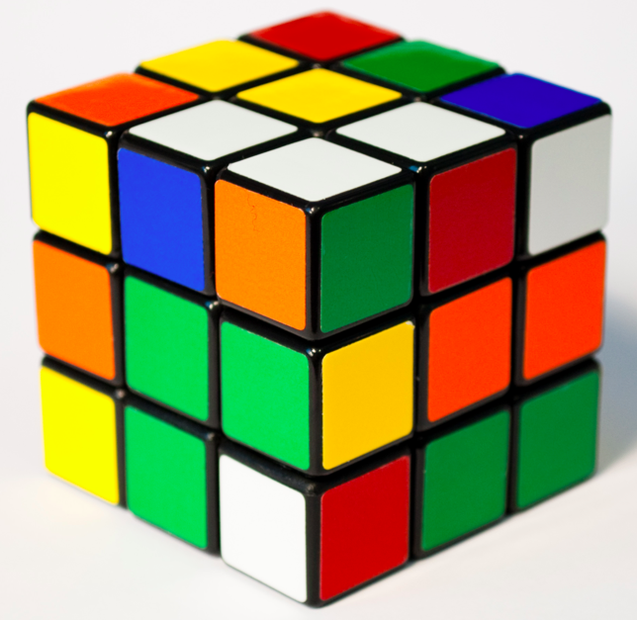
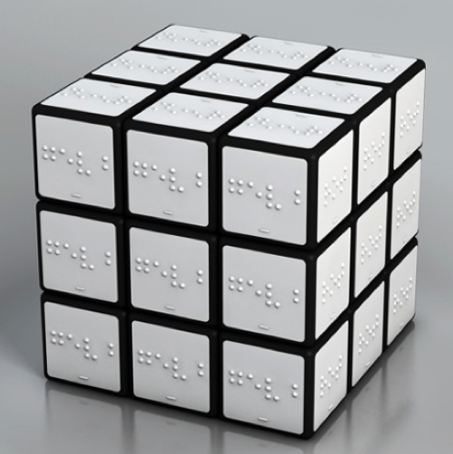
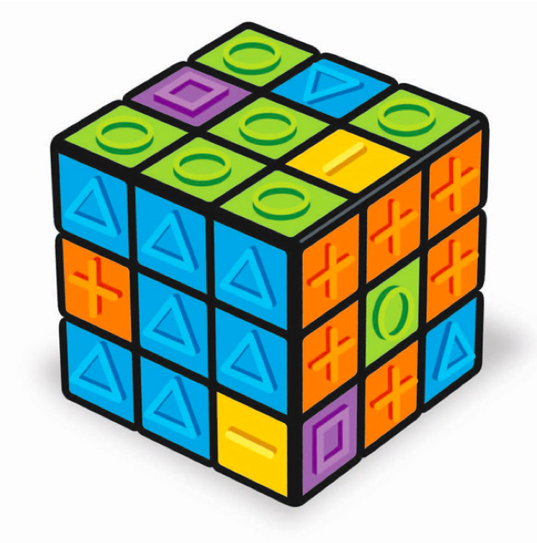
Designing for Learner Variability

Slide 12
Environment vs. Disability
Signs Restaurant Link
In what ways does the educational environment positively or negatively affect student outcomes?

Slide 13
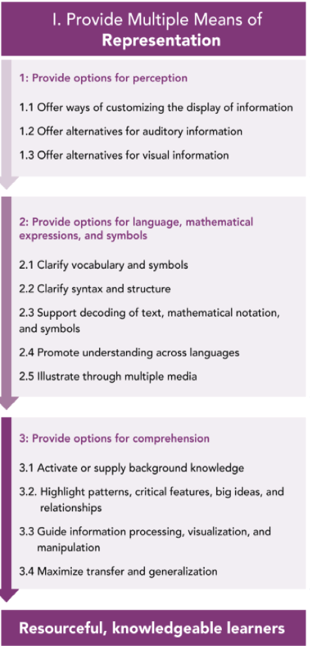
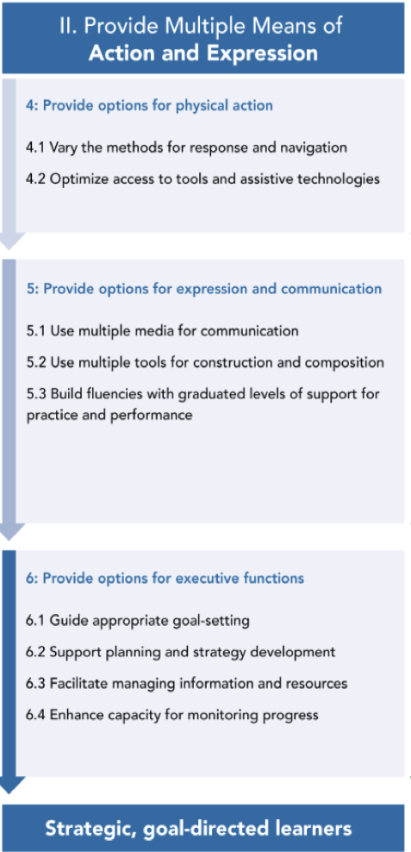
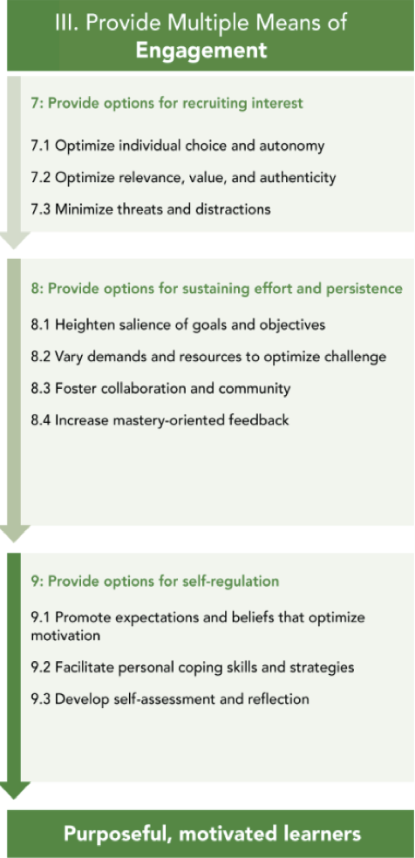
OUTDATED

Slide 14
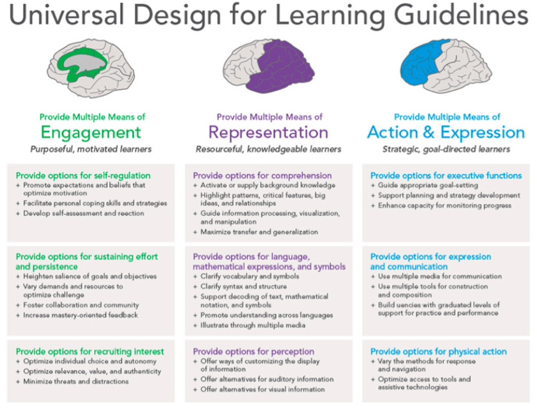
UPDATED
© CAST, 2014

Slide 15
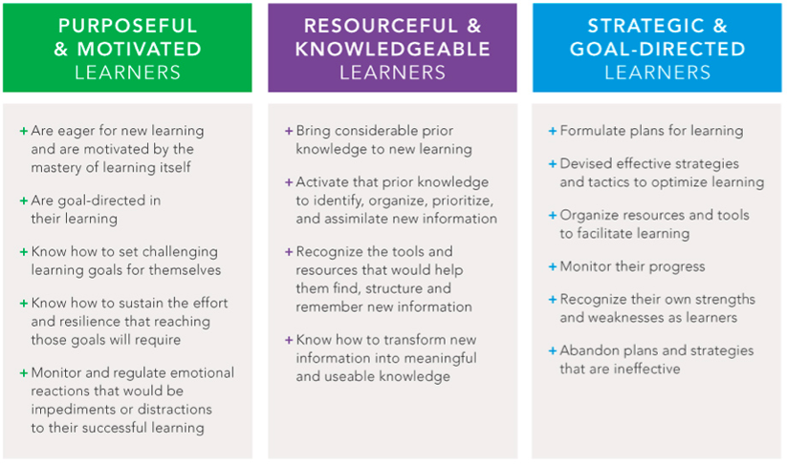
Expert Learners Are…
© CAST, 2014

Slide 16
The Integration of
Cognition and Emotion
Universal Design for Leaning: Theory and Practice, 2014
They (the UDL guidelines) explicitly call for the integration of emotion and cognition. We know that students continuously appraise their environment as good for them or bad for them—beneficial or threatening.

Slide 17
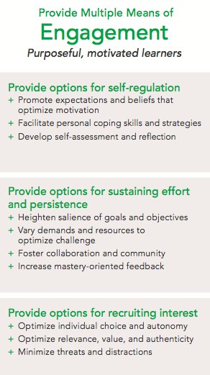
UDL: Engagement
-Universal Design for Learning: Theory and Practice, 2014
It is critically important to design learning contexts that offer flexibility in the domain of engagement so that each student can find a way into the learning experience, remain persistent in the face of challenge or failure, and continue to build self-knowledge.
© CAST, 2014

Slide 18
UDL: Engagement Activity
The Cognitive/Emotional Connection
CCSS.L.K-12.5
I can teach it
Bring it on!
Cognitive State
Open/Willing/Tentative
I am learning
Emotional State
I haven’t a clue
Resistant/Anxious/ Exhausted

Slide 19
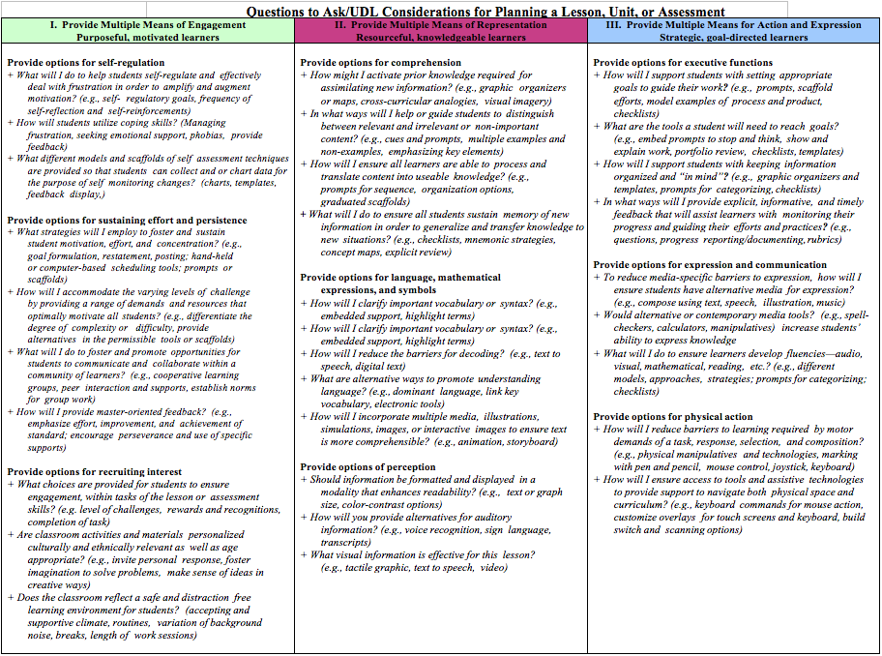

Slide 20
Observe and Refine a Classroom Lesson
With a partner, review the contents of the Engagement principle on the Lesson Considerations/Question chart
Discuss Engagement strategies you’ve observed or have used in a classroom setting. List these strategies on the blank template
Observe the following lesson noting Engagement strategies on Lesson Considerations/Question template
http://www.edutopia.org/math-social-activity-cooperative-learning-video

Slide 21
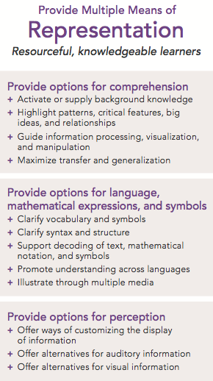
UDL: Representation
Universal Design for Learning: Theory and Practice, 2014
Learners' ability to perceive, interpret, and understand information is dependent upon the media and methods through which it is presented.
© CAST, 2014

Slide 22
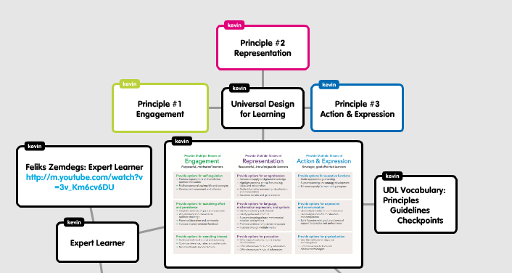
UDL: Representation Activity
Go to: http://www.popplet.com

Slide 24
Observe and Refine a Classroom Lesson
With a partner, review the contents of the Representation principle on the Lesson Considerations/Question chart
Discuss Representation strategies you’ve observed or have used in a classroom setting. List these strategies on the blank template
Observe the following lesson noting Representation strategies on Lesson Considerations/Question template
http://www.edutopia.org/tech-to-learn-free-online-resources-video

Slide 25
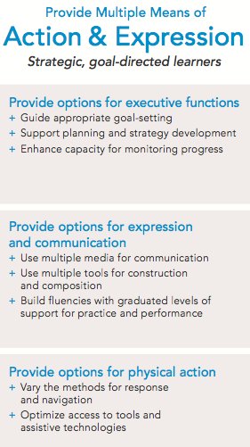
UDL: Action & Expression
Design and Deliver, Lord Nelson (2014)
The principle of Action and Expression is about providing opportunities for students as they practice goal setting, planning, strategy building, organizing and using information and resources, and monitoring their own progress.
© CAST, 2014

Slide 26
UDL: Action & Expression Activity
How would you choose to demonstrate (express) your understanding of the information presented today based on your strengths, interests and preferences?

Slide 28
Observe and Refine a Classroom Lesson
With a partner, review the contents of the Action & Expression principle on the Lesson Considerations/Question chart
Discuss Action & Expression strategies you’ve observed or have used in a classroom setting. List these strategies on the blank template
Observe the following lesson noting Action & Expression strategies on Lesson Considerations/Question template
http://www.edutopia.org/tech-to-learn-free-online-resources-video

Slide 29
Curriculum Defined “Copernicus Shift”
Universal Design for Learning: Theory and Practice, 2014
Goals
Assessment
Methods
Materials

Slide 30
Goals
Universal Design for Learning: Theory and Practice, 2014
Separate the means from the ends;
Consider all three learning networks;
Challenge all learners;
Actively involve learners

Slide 31
Standard/Goal Analysis
Tell and write time.
CCSS.Math.Content.1.MD.B.3: Tell and write time in hours and half-hours using analog and digital clocks.
Goal:
Students will express time in hours and half-hours using analog and digital clocks.

Slide 32
Watch Your Verbs!
Apply Demonstrate Identify Order
Assess Describe Interpret Predict
Classify Diagram Label Reproduce
Compose Distinguish Locate Solve
Construct Estimate Measure State
Define Evaluate Name Translate

Slide 33
Assessment
Universal Design for Learning: Theory and Practice, 2014
Are ongoing and focused
on learner progress
Measure both product
and process
Are flexible, not fixed
Are construct relevant*
Actively inform and
involve learners
Formative
Summative
* The information or skill an assessment or assessment item claims to be measuring.

Slide 34
Methods
Universal Design for Learning: Theory and Practice, 2014
Instructional methods include the decisions, approaches, procedures, and routines that teachers use to accelerate or enhance learning. Because learners vary in the ways they become and stay motivated to learn, comprehend information, and strategically approach tasks, the UDL framework emphasizes the need to employ many kinds of teaching methods. Flexible and varied, these methods are adjusted based on continual monitoring of learner progress.

Slide 35
Materials
Universal Design for Learning: Theory and Practice, 2014
Align to goals
Fixed media of the past, especially print, shaped and even warped our understanding of what it meant to be an effective learner. Essentially, those people who could function well in a print-based environment were favored; we even called them "book smart." Those for whom print presented difficulties-individuals with dyslexia, say, or whose first language was not English, or those who were oriented more toward visual or auditory media-were shut out. Educational materials limited the goals of learning through contingencies and assumptions.

Slide 36
Materials
Universal Design for Learning: Theory and Practice, 2014
Engage learners in becoming proactive
Just as educators now have many more options in the post-print age, so do learners. The days of knowledge being dispensed through one of two gatekeepers-the teacher or the textbook-are long gone.

Slide 37
Five UDL Take-Aways
Not added on later – but designed from the
beginning.
Diversity/variability is the norm.
Multiple means of engagement,
representations and action/expression, and
will benefit all learners
UDL is the instructional ‘HOW’ for the ‘WHAT’ of
CCSS.
First focus on the curriculum – goals,
assessment, methods, and materials; then on
individual students

Slide 38
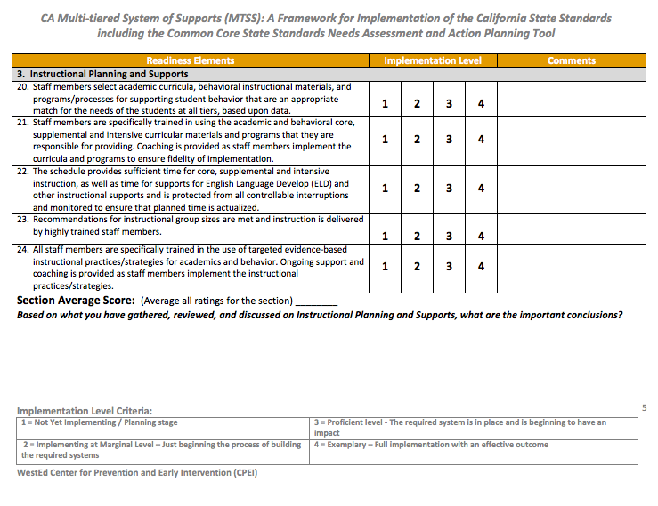
Instructional Planning and Supports

